Slide 1
Scrum & ETFS – Part II
Lunch and Learn – Nov 18, 2014
Mike O’Brien

Slide 2
Agenda
Scrum Recap
ETFS Demos
Team Project Setup
Build the Backlog
Release Planning
Sprint Planning
Daily Standup
Sprint Review
Sprint Retrospective
ETFS – Overview

Slide 3
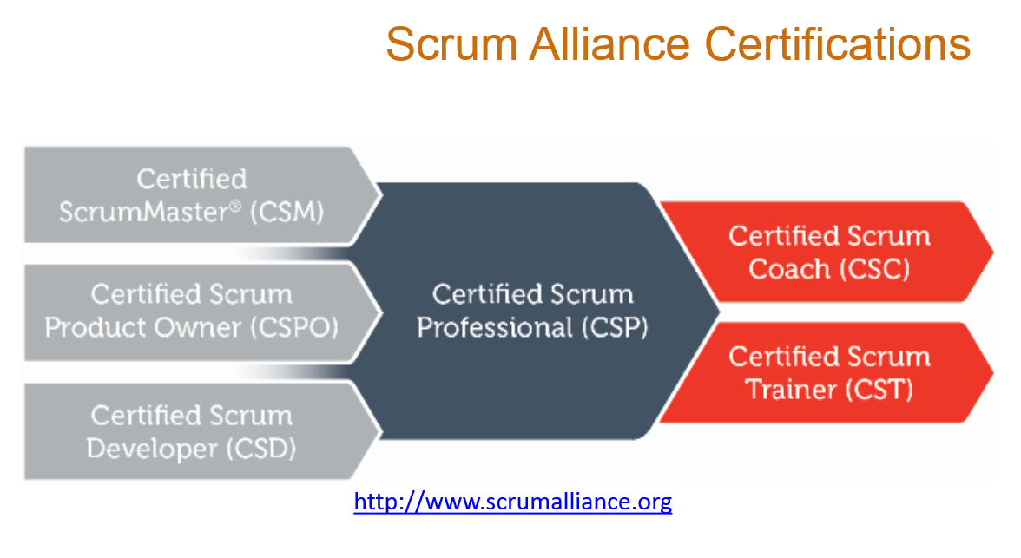
ScrumMaster Training
Attended ScrumMaster training in early August from cPrime
Overview of the training, i.e., 2 days in 1 hour

Slide 4
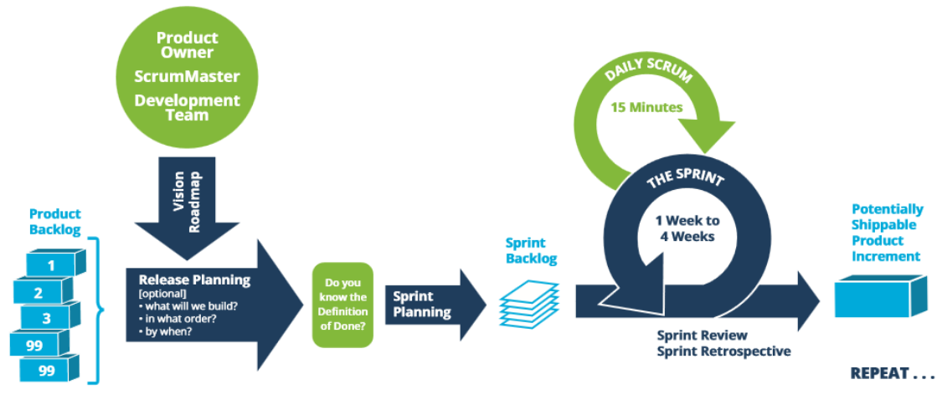
Scrum

Slide 5
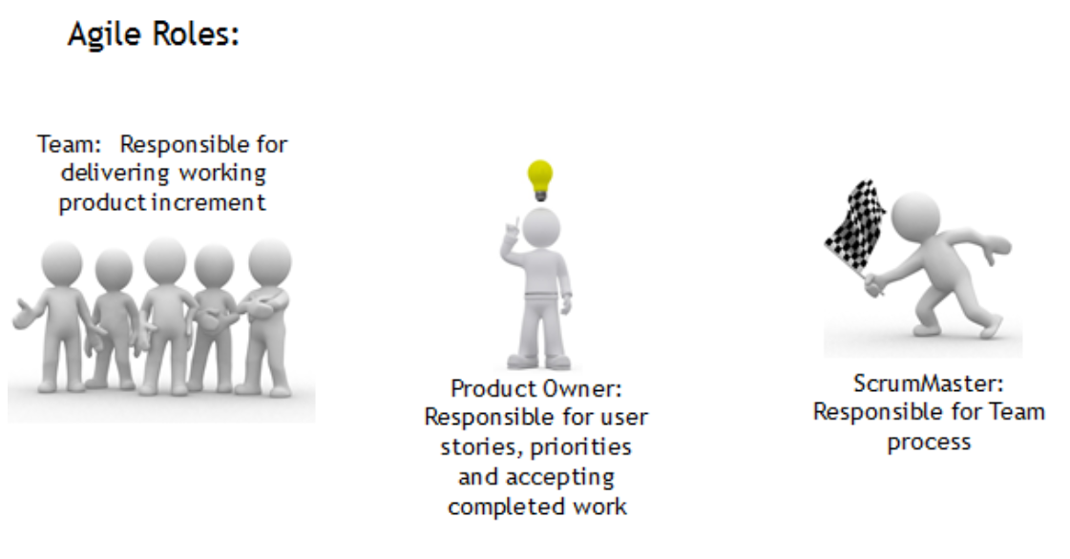
Scrum Roles

Slide 6
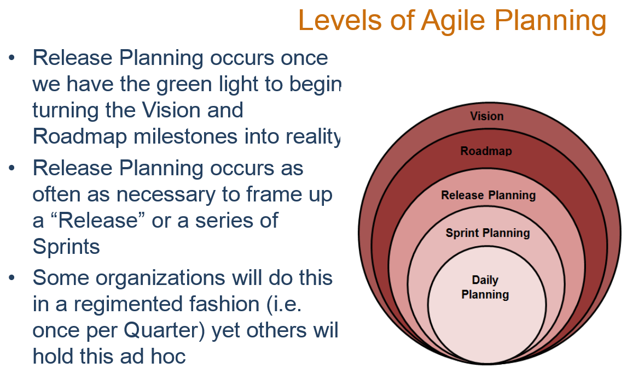

Slide 7
Scrum Ceremonies (Meetings)
Sprint Planning: held at the beginning of each sprint for the team to commit Product Backlog Items to the Sprint Backlog
Sprint Standup (Daily Scrum): a 15 minute time-boxed event for the Team to inspect, adapt and transparently synchronize on the Sprint Goal
Sprint Review: Feedback mechanism for stakeholders to see working product increments
Sprint Retrospective: an inspect and adapt mechanism for the Team regarding their Process

Slide 8
Scrum Ceremonies (Meetings)
Release Planning (Optional): An optional session that comes from the eXtreme Programming framework
A Release is made up of multiple Sprints or Iterations
In this session the Product Owner, ScrumMaster, and Team and anyone else necessary collaborate on:
What to Build
In What Order
By When

Slide 9
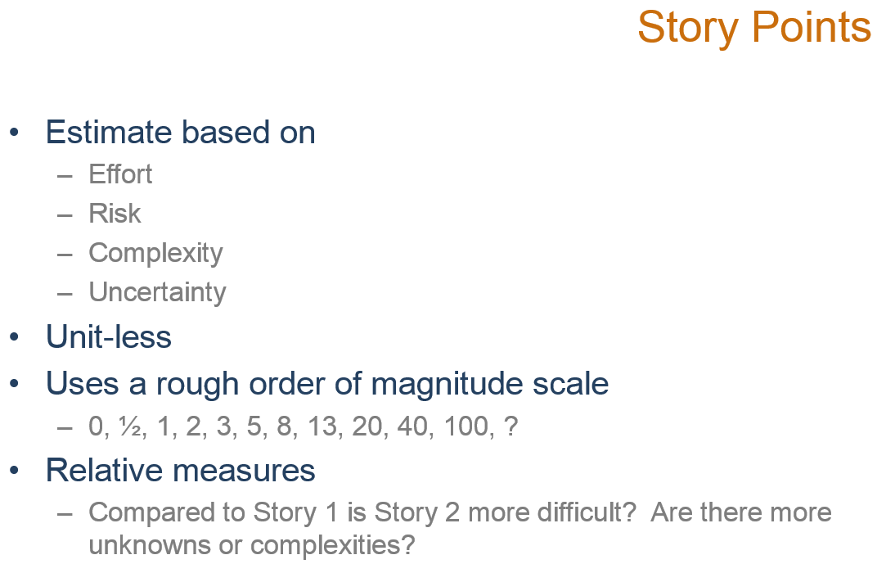

Slide 10
ETFS
Demo Project on tfsdev.mmm.com
Team Project Setup
Request new Team Project
Permissions - Setup Teams and work areas
Area Paths
Iterations – “Timebox” your iterations

Slide 11
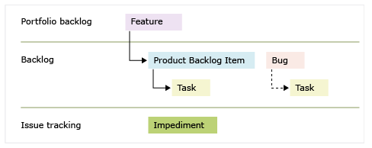
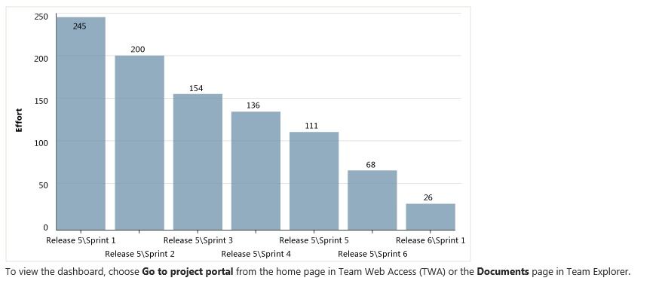
ETFS
Demo Project on tfsdev.mmm.com
Release Planning / Build the Backlog
What to Build
In What Order
By When

Slide 12
ETFS
Demo Project on tfsdev.mmm.com
Sprint Planning
Part I: Determine “what” Product Backlog Items will be completed in the Sprint by the Team (the Goal)
Part II: Determine “how” the work will be completed in the Sprint by the Team (the Tasks)
Capacity Planning

Slide 13
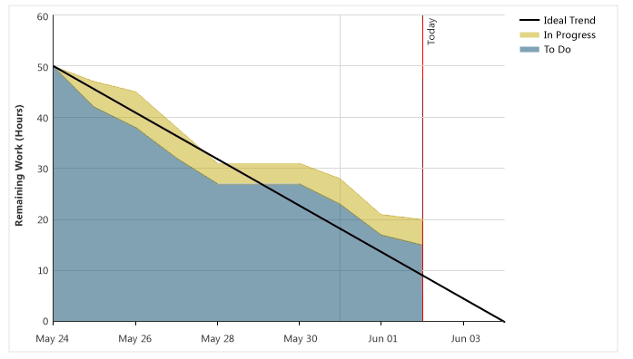
ETFS
Demo Project on tfsdev.mmm.com
Daily Standup
Team inspects and adapts
Burndown
Update Tasks

Slide 14
ETFS
Demo Project on tfsdev.mmm.com
Sprint Review
Prior – final update of tasks
Mark Product Backlog Items complete if accepted by Product Owner, otherwise return to Backlog

Slide 15
ETFS
Demo Project on tfsdev.mmm.com
Retrospective
What went well?
Recognize simple but effective things
Focus on the Team – not the Product
What did Not go so Well?
Identify impediments – create Impediments to track issues over time

Slide 16
Enterprise Team Foundation Server
Overview
Mike O’Brien
November 2014

Slide 17
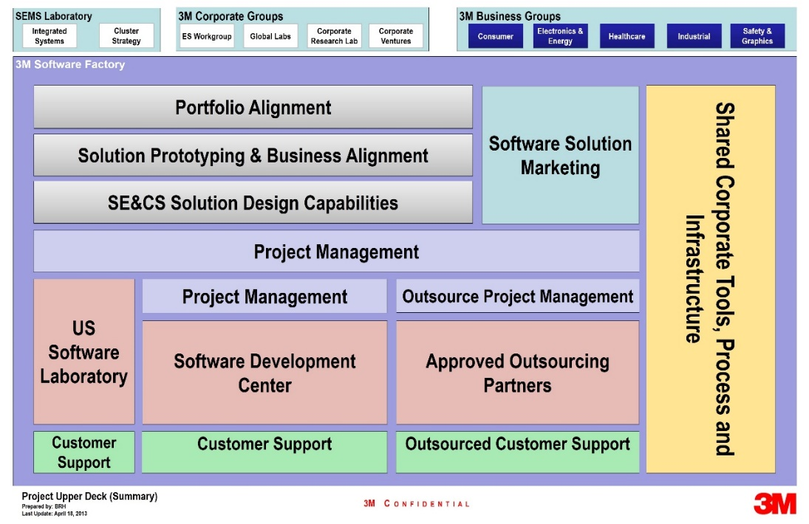












3M Software Factory – Software Engineering for the Future
Building the software engineering capabilities needed to enable rapid, high-quality and profitable product development.
Specialized Software Skillsets
Software Process Development
State of the Art Software Infrastructure
Divisions + ES Workgroup
Goal
Provide an Enterprise ALM Service for all 3M Software teams.

Slide 18
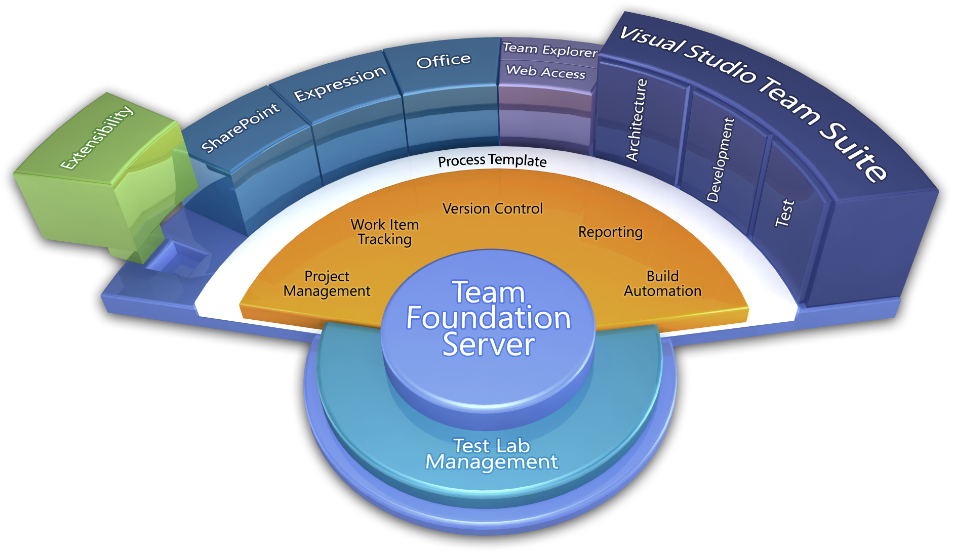
What is Team Foundation Server (TFS)?
Team Foundation Server is a Microsoft product which provides source code management, reporting, requirements management, project management, automated builds, lab management, testing and release management capabilities.
Process / Optimization
Project Management
Requirements Management
Design & Architecture
Release Management
Development
QA & Test
Application Lifecycle Management (ALM)
Application Lifecycle Management using Visual Studio Team Foundation Server provides proven practices to manage application lifecycle. Manage source code across teams; develop, build, and test applications; plan projects, track work, and report progress.

Slide 19

Support
Infrastructure hosted in 3M Data Centers
High Availability install of Team Foundation Server
Load Balanced across multiple machines
99.9% predicted uptime
Database cluster
High Availability of Data
Managed 3M IT Database Team
Backups follow 3M standards for data retention
Training Available for TFS and Scrum
Developers
Project Managers/ScrumMasters
Product Owners
Testers
Stakeholders
System Support 24x7x365 via 3-1000 or http://ithelp.mmm.com

Slide 20
ETFS Team Structure
Service Manager
- Initial contact of new teams
- Provide training
- Maintain relationship with teams
Operations (Ops)
- IT Operations Team (Managed Infrastructure)
DevOps
- Team onboarding tasks
- Service enhancements
- Test updates/upgrades, update documentation
- Perform DevOps role for SEMS and Division teams as needed
- ETFS System Maintenance
- Respond to support requests
- Focused on PROD system

Slide 21
ETFS Architecture – QA and PROD

Slide 22
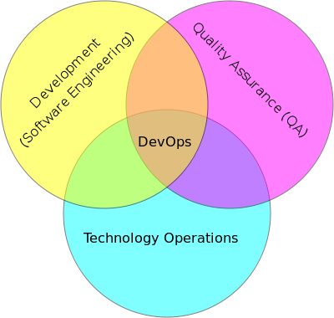
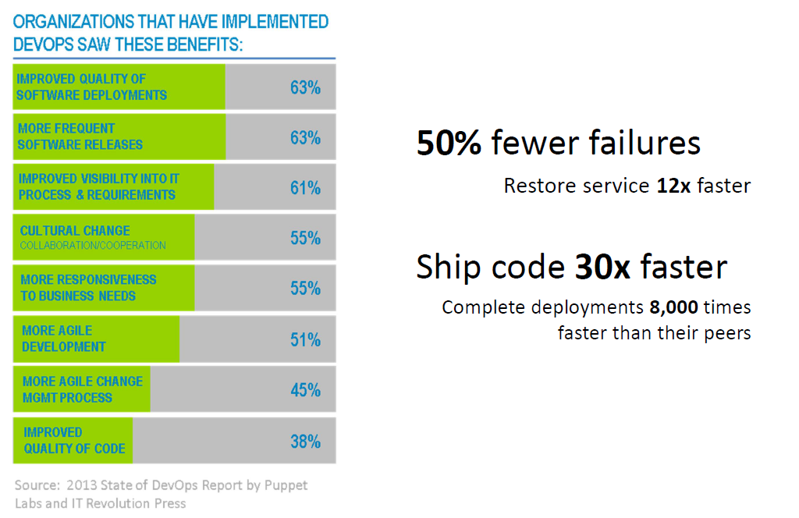
SEMS DevOps
DevOps Role
Automate Build, Deployment, Configuration, Testing and production deployment
SEMS DevOps Role
ETFS - Team Onboarding and Migration
ETFS - Service Enhancements
Perform DevOps Role for SEMS and Division Teams (T&M)
Notes:
“Automate Everything”

Slide 23
Technology Platform and Roadmap
Requirements
Authoring Requirements document with Enterprise defined structure, methodology, and process
Cloud Hybridization
Cross Platform Builds
(iOS / Xamarian / Android / Linux)
Rollup Reporting
(self-service reporting portal)
Value Added
DevOps
Automated build, deploy and testing harnesses
Enterprise Software Development Process
Process Template
Project Management
Requirements Management
Version Control
Test Case Management
Build Automation
Reporting
TFS Technology
Platform
TFS

Slide 24

Technology Roadmap
Build Services - Enterprise Build Farm
Native Build machines (Windows / .Net / Visual Studio)
Cross Platform Builds – Java/Android, iOS
Test Management Services
Enterprise Test Controllers
Rollup Reporting - Enterprise Reporting
Reports across Team Projects / Businesses / Divisions
Deployment Services
- Automate Build, Configuration, Deployment, Testing, and Production Environments
Notes:
“Automate Everything”

Slide 25
ETFS Timeline
HIS Target for all Rational Teams migrated
Governance Policies Established
Start Onboarding HIS Teams
All SEMSTFS Teams Migrated
IPD/FSD Migrated
Start MVSS Migration
Service Available
2015
Oct
Nov
Dec
Jan
Feb
Mar
Apr
May
Jun
Jul
Aug
Sep
Oct
Nov
Today

Slide 26

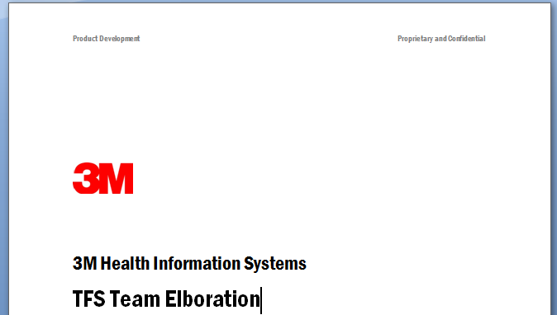
ETFS Onboarding Workflow
Continuously re-evaluate the onboarding process
Enroll
Elaboration
Training
Migration
Adoption
Team Identification…
Workflow requirements
Workflow customizations
Source control requirements
Build/CI requirements
Delegate task to gather team members and define sub-teams
Delegate task to define areas
Delegate task to define sprint schedule
Identify Team Interdependencies
Delegate Licensing Inventory
Schedule…
Timeframes
Training
Materials…
TFS Getting Started Guide*
Scrum Primer*
Requirements
Prioritize
Match to solutions
Add team to queue
Find possible scenario(s)
Migration Plan
Workflow Scenarios
Representative Migration
Technical Scenarios
Migration
Snapshot Migration
Source Migration
Archive Availability
General TFS Training
Developer TFS Training
Project Management Training
Test Manager Training (optional)
Data Migration
Calculate production impact
Respond to environment issues
Monitor
Re-evaluate
Impact
Time
Scenario Time
Downtime
Environment
Support
Maintenance
Follow up training
Process
Part-time
Ongoing
Refer to “TFS Team Elaboration Details”
Refer to “Migration Guidance and Readiness”
* = In Progress

Slide 27
Onboard – Environment Migration
DEV
tfsdev.mmm.com
QA
tfsqa.mmm.com
PROD
tfs.mmm.com
Team Projects are ‘disposable’
Flexible on permissions
Create multiple team projects – if needed
Prototype the Team Project
Workflow customizations
Source control structure and migration
Permissions / Groups / Teams
Schedule Promotion to QA
Test workflow
Perform source migrations test
First target for Updates/Upgrades
Team Projects same as PROD
Permissions identical to PROD
Staging for PROD
Test Migration Plan
Perform source migration test
Representative Migration
Technical Scenarios
Updates & Upgrades
3. Schedule Promotion to PROD
Snapshot Migration
Source Migration
Archive Availability
1. Go Live Launch
Communicate to team
Perform Migration
Archive Availability
2. Team Projects
Permanent home
Final target of Migration
Process Template changes –

